Slide 1
Ch. 3: Image Display
The goodness of display of an image depends on
(a) Image quality:
i) Spatial resolution, ii) Quantization
(b) Display device:
i) Monitor type (CRT, LCD),
ii) Monitor resolution
iii) Graphics card
iv) Printer
(c) Working environment:
e.g., Ambient lighting
3-<number>

Slide 2
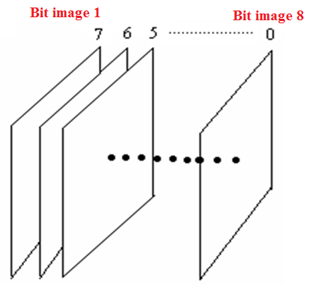
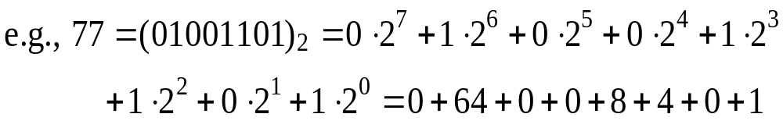
。Grayscale image: 0-255
。Bit images 。Binary image: 0, 1
Bit image 1: most
significant bit
image
Bit image 8: least
significant bit
image
3-<number>

Slide 3
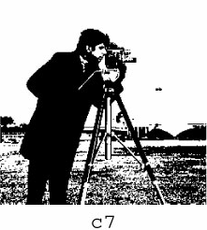
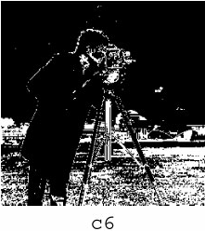
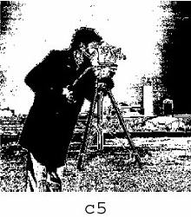
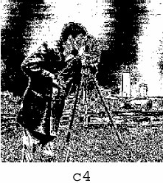
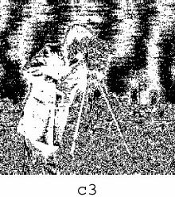
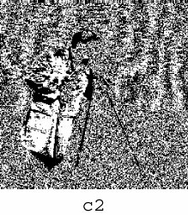
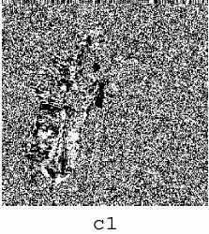
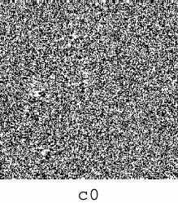
Bit image 1
Bit image 8
3-<number>

Slide 4
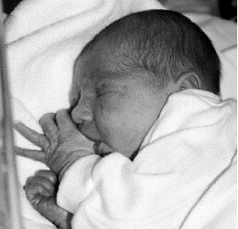
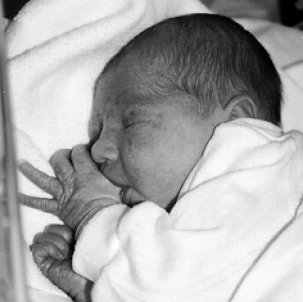
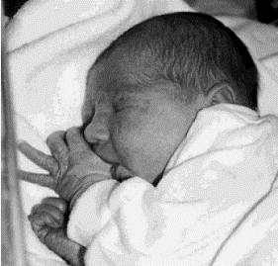
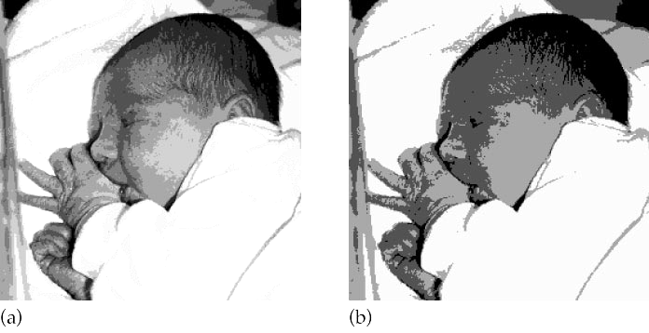
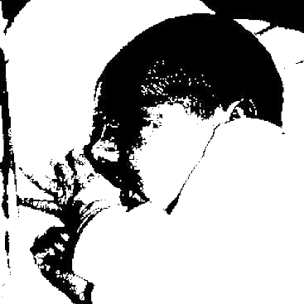
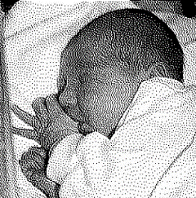
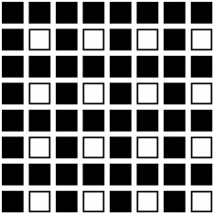
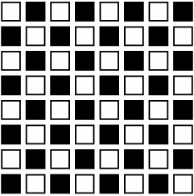
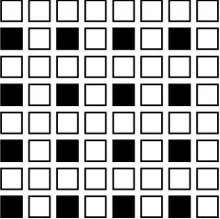
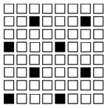
Dithering
-- The process of reducing the number of gray
levels in an image using patterns of dots to
simulate shades of gray
○ Uniform Quantization
False contours
128
64
32
8
4
2
Halftoning –
Represents an
image with 2
tones
3-<number>

Slide 5
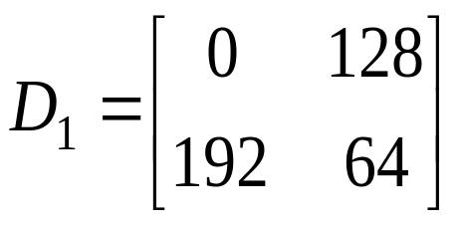

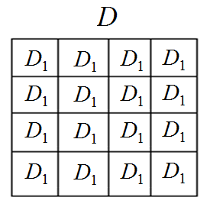
Steps:
Step 1: Construct a dithering matrix
Step 2: Generate dithering array D of image size
by repeating
3-<number>

Slide 6
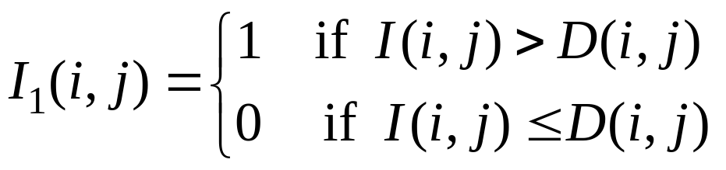

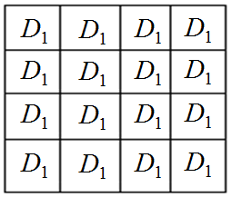
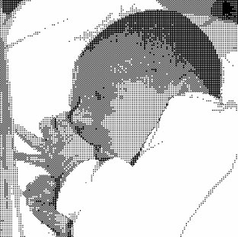

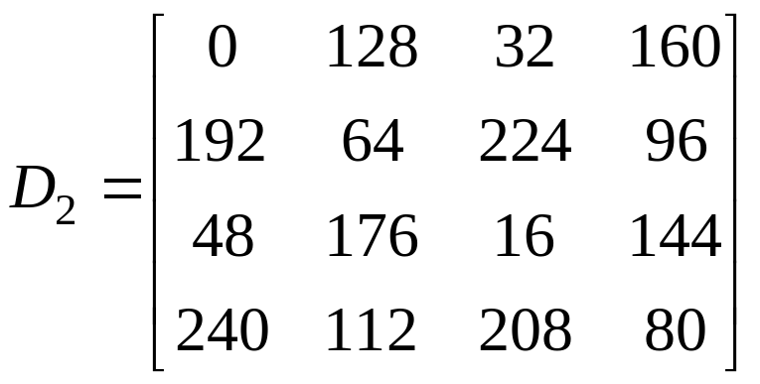
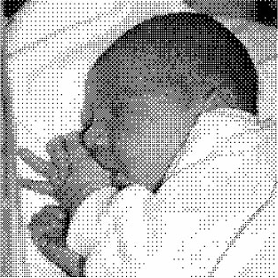

Step 3: Thresholding
I
D
The larger the dithering matrix, the more random in dot scattering
3-<number>

Slide 7
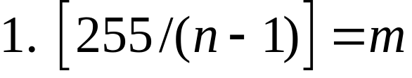
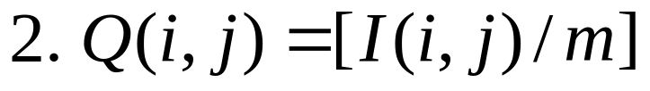
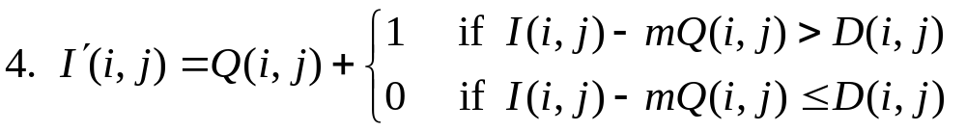
○ Extend to more than two gray values
Let n: the number of output gray values
3. Scale dithering array D so that its values are in
the range [0, m]
3-<number>

Slide 8


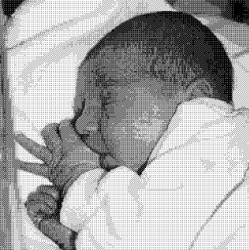
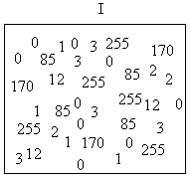
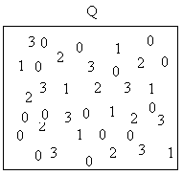
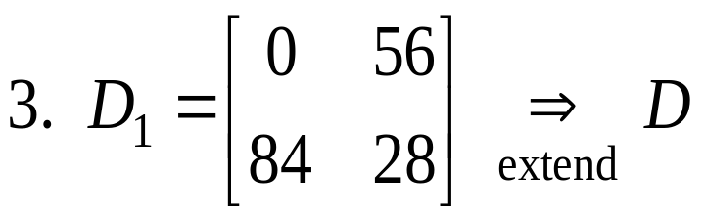
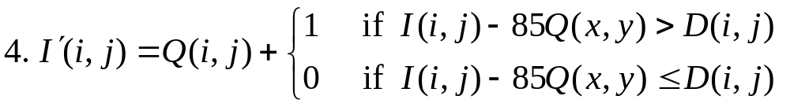
Example 1: 4 output gray values 0, 1, 2, 3
1. 255 / 3 = 85
3-<number>

Slide 9



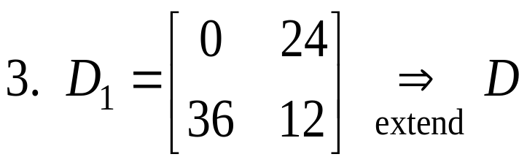
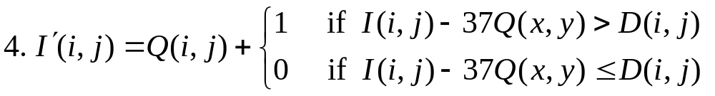
Example 2: 8 output gray values 0, …., 7
1. 255 / 7 = 37
3-<number>

Slide 10

3-<number>

Slide 11

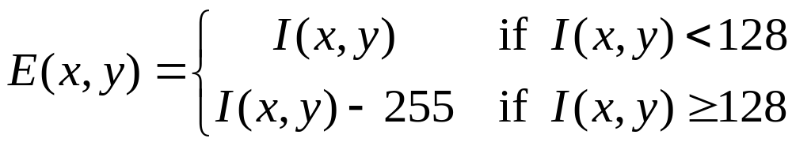
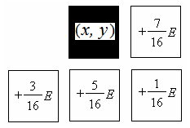
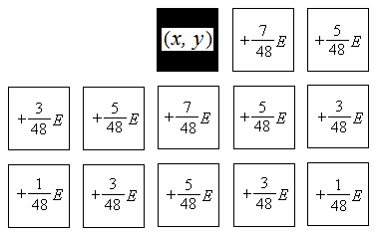

○ Error diffusion dithering
For each pixel ,
1) Calculate quantization error
2) Spread the error according to
Floyd-Steinberg
Jarvis-Judice-Ninke
3) Quantize new to
0 or 1 using 128 as the threshold
3-<number>

Slide 12

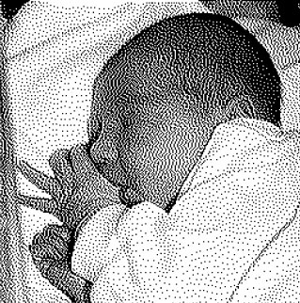
Floyd-Steinberg
Jarvis-Judice-Ninke
3-<number>

